Slide 1



Career Guidance Platform [ Devroots ]
Supervised By : Dr. Manal Shaaban
Teaching Assistant : Eng. Ahmed Gomaa

Slide 2

Team Members :
Mohamed Khaled Abdeltawab
Abdelrahman Maged Abdeldayem
Abdelrahman Rezk Mohamed
Ziad Elamir Mohamed
Nourhan Khaled Shipa
Rania Rabie Sayed
Shrouk Ahmed Rashad
1

Slide 3

AGENDA
1
2
3
4
5
Problem Statement
Aims & Objectives
Related Work
Requirements
System Analysis
6
Website
7
Future Work
2

Slide 4
AGENDA
1
2
3
4
5
Problem Statement
Aims & Objectives
Related Work
Requirements
System Analysis
6
Website
7
Future Work
3

Slide 5



Problem Statement
Introduction
Problem
Challenges
4

Slide 6

Problem Statement
1.1 INTRODUCTION
Career guidance sites play a crucial role in helping students, job seekers, and professionals looking to advance or switch careers
the right career path can be challenging for students and graduates. Career Guidance is a web platform designed to help users identify suitable career paths based on their interests, skills, and market demands
5

Slide 7

Problem Statment
1.2 PROBLEM
When someone wants to learn programming or is just starting out in college, they often don't know where to start or how to choose the right track for them. This can be frustrating and lead to wasted time and effort.
The problem is that most people don't have a good understanding of the different programming tracks available and what they entail. They may rely on the advice of others, who may be biased towards their own track, or they may simply try to learn everything at once, which is often overwhelming and ineffective.
6

Slide 8

Problem Statment
1.3 CHALLENGES
Clear & Structured Roadmaps
Content in Arabic and English
Ease of use
Friendly Learning Resources
A good understanding of the fundamentals
Raising awareness through following expert individuals Training for interviews through mock interviews with experts
7

Slide 9
AGENDA
1
2
3
4
5
Problem Statement
Aims & Objectives
Related Work
Requirements
System Analysis
6
Website
7
Future Work
8

Slide 10


Aims & Objectives
9

Slide 11

Aims
Interactive Career Guidance Platform: Aims to assist Arab individuals starting their career journey
Simplified Learning Process: Provides clear and structured roadmaps.
Foundational Knowledge: Covers essential concepts for various career tracks.
Practical Resources: Offers tools and materials for hands-on learning.
Career Progression: Helps users build confidence and advance in their chosen field.
10

Slide 12

Objectives
Provide Clear Learning Roadmaps: Structured guides to navigate career paths efficiently.
Focus on Essential Fundamentals: Ensure a strong knowledge base for beginners.
Enhance Awareness through Expert Insights: Gain industry knowledge from professionals.
Foster a Supportive Learning Community: Encourage collaboration and peer support.
Offer Practical Interview Training: Prepare users with real-world interview scenarios
11

Slide 13
AGENDA
1
2
3
4
5
Problem Statement
Aims & Objectives
Related Work
Requirements
System Analysis
6
Website
7
Future Work
12

Slide 14


Related Work
Existing Similar
Systems
Gaps
13

Slide 15

3.1 EXISTING SIMILAR SYSTEMS:
Related Work
Limited Existing Solutions: Few platforms offer comprehensive career guidance.
Missing Key Features: Lacks foundational knowledge, expert insights, and interactive community support.
Gap in the Arabic Community: No dedicated platforms catering to Arab beginners.
Comparison with Roadmap.sh : Primarily provides roadmaps without a full support system.
14

Slide 16

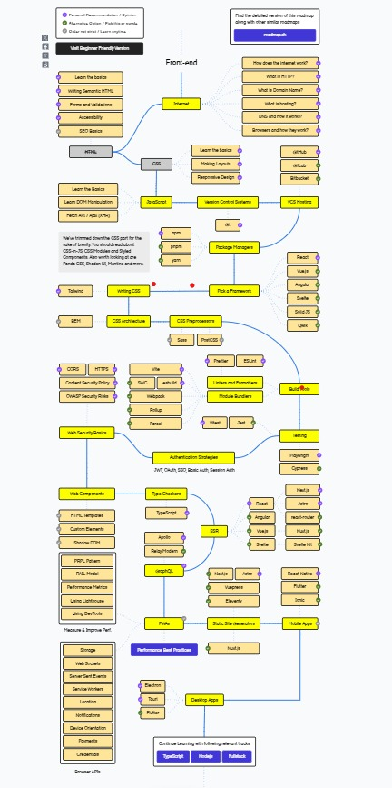
Related Work
3.2 Gabs:
Not Beginner-Friendly.
Absence of Structured Explanations.
Limited Educational Arabic Resources.
Low Recognition in the Arabic Community.
All available sources are articles
15

Slide 17
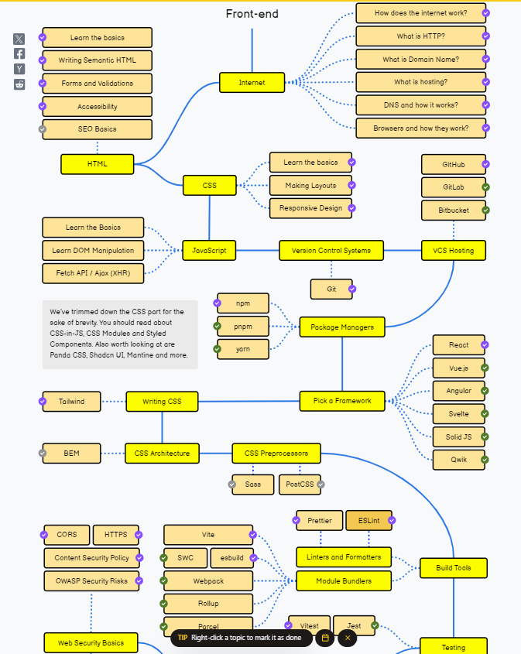
3.2 Gabs:
The roadmap is complex
And presents all specializations within the track together, making it overwhelming for beginners
16

Slide 18
AGENDA
1
2
3
4
5
Problem Statement
Aims & Objectives
Related Work
Requirements
System Analysis
6
Website
7
Future Work
17

Slide 19

Requirements:
4.1 Requirement Gathering:
Ask in groups
Interview with new student
Votes
Documentation analysis
18

Slide 20

4.2 Requirements analysis:
Functional
Non-Functional
19

Slide 21

4.2 (1) Functional Requirements:
User Registration & Login
Career Path Recommendations
View Interview Experiences
Saving Progress Bar
Access Learning Resources
Admin – Manage( Tracks – Users – Analysis)
Instructor – Manage( View – Accept – Tracks)
20

Slide 22

4.2 (2) Non-Functional Requirements:
Performance The system should respond quickly and handle multiple users efficiently.
Security User data and system APIs must be protected from unauthorized access.
Availability The platform should be available 24/7 without significant downtime.
Usability The user interface must be intuitive and easy to navigate.
Scalability The system should be able to grow and support future features or users.
21

Slide 23
AGENDA
1
2
3
4
5
Problem Statement
Aims & Objectives
Related Work
Requirements
System Analysis
6
Website
7
Future Work
22

Slide 24


System Analysis
23

Slide 25
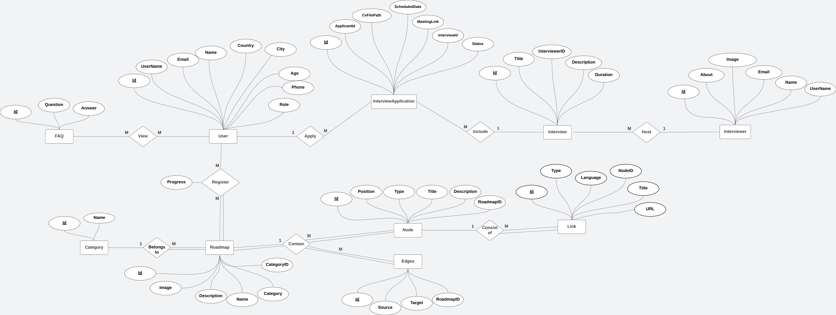
4.1 ERD
24
Notes:
https://lucid.app/lucidchart/993317ec-98a5-4fd8-beff-b0e6b6177ac8/edit?viewport_loc=-687%2C-996%2C3293%2C1227%2C0_0&invitationId=inv_3080d487-411c-4fdb-b04a-278d2f8584b0

Slide 26
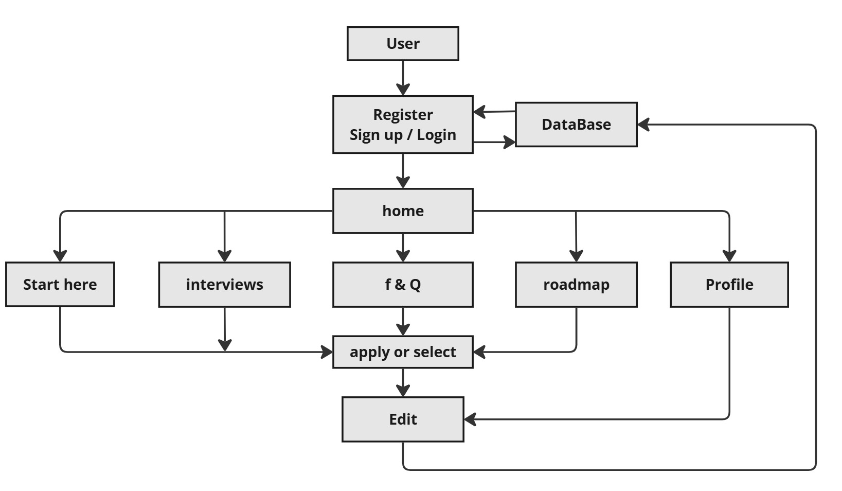
4.2 SYSTEM ARCHITECTURE
25

Slide 27
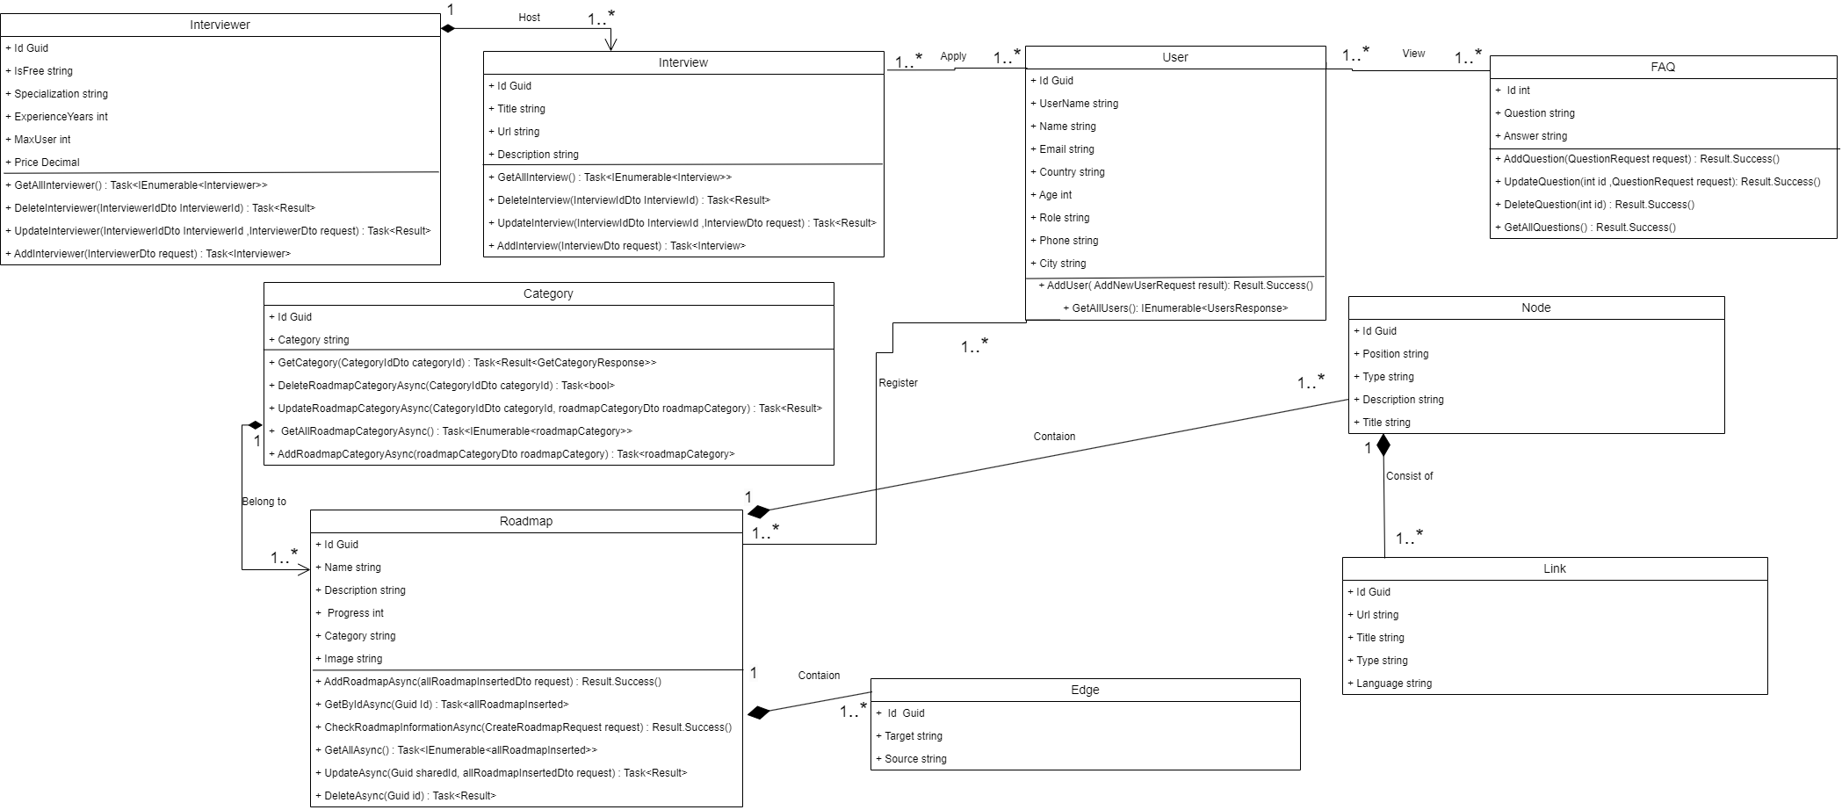
4.3 Class Diagram
26

Slide 28

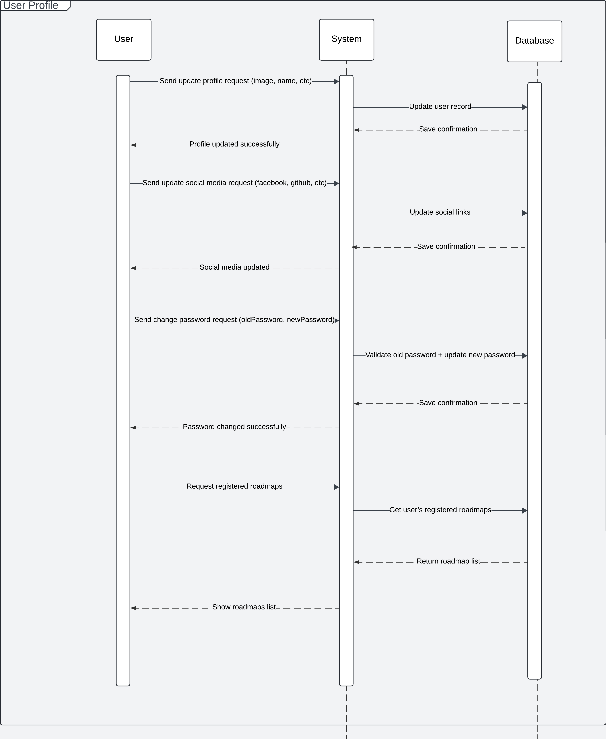
4.4 Sequence Diagram
27
Notes:
https://lucid.app/lucidchart/993317ec-98a5-4fd8-beff-b0e6b6177ac8/edit?viewport_loc=-687%2C-996%2C3293%2C1227%2C0_0&invitationId=inv_3080d487-411c-4fdb-b04a-278d2f8584b0

Slide 29
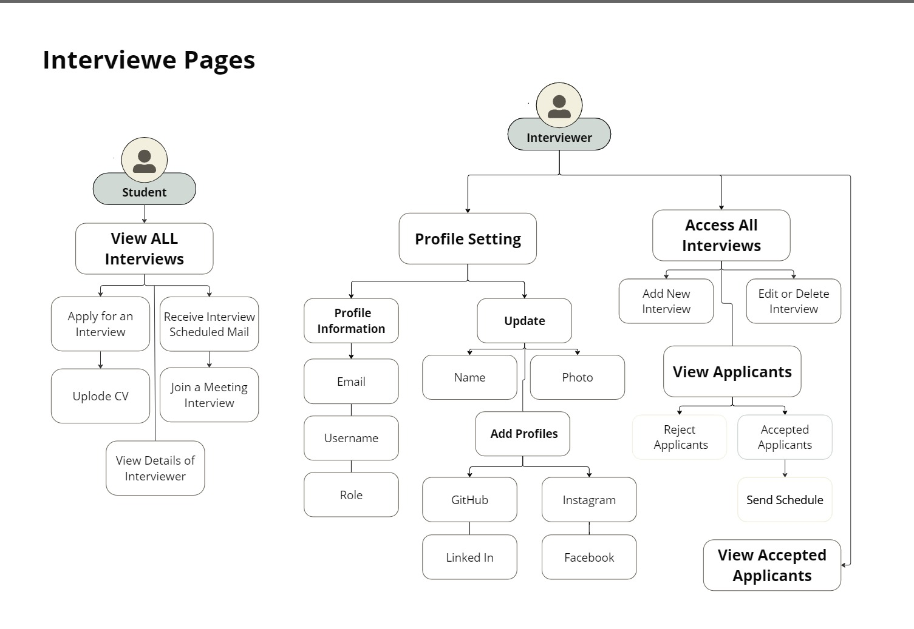

4.5 Use Case Diagram
28
Notes:
https://miro.com/app/board/uXjVKteWARA=/

Slide 30
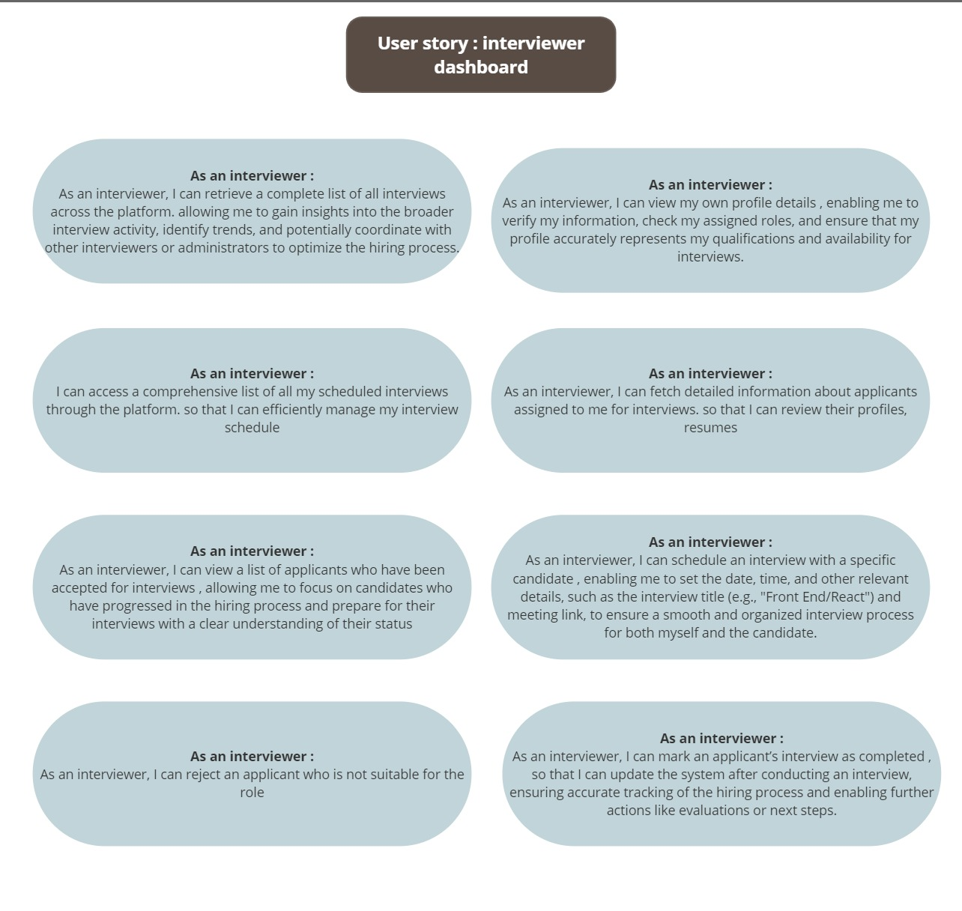
4.6 User Story Diagram:
29
Notes:
https://miro.com/app/board/uXjVKteWARA=/

Slide 31
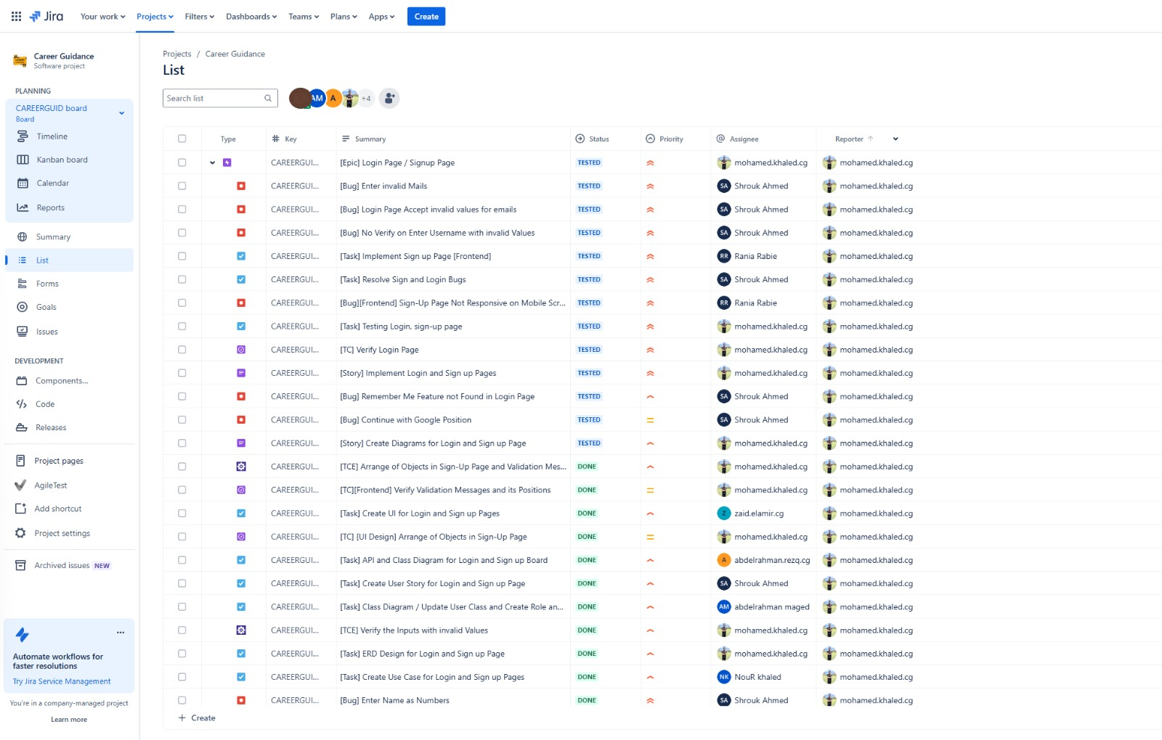
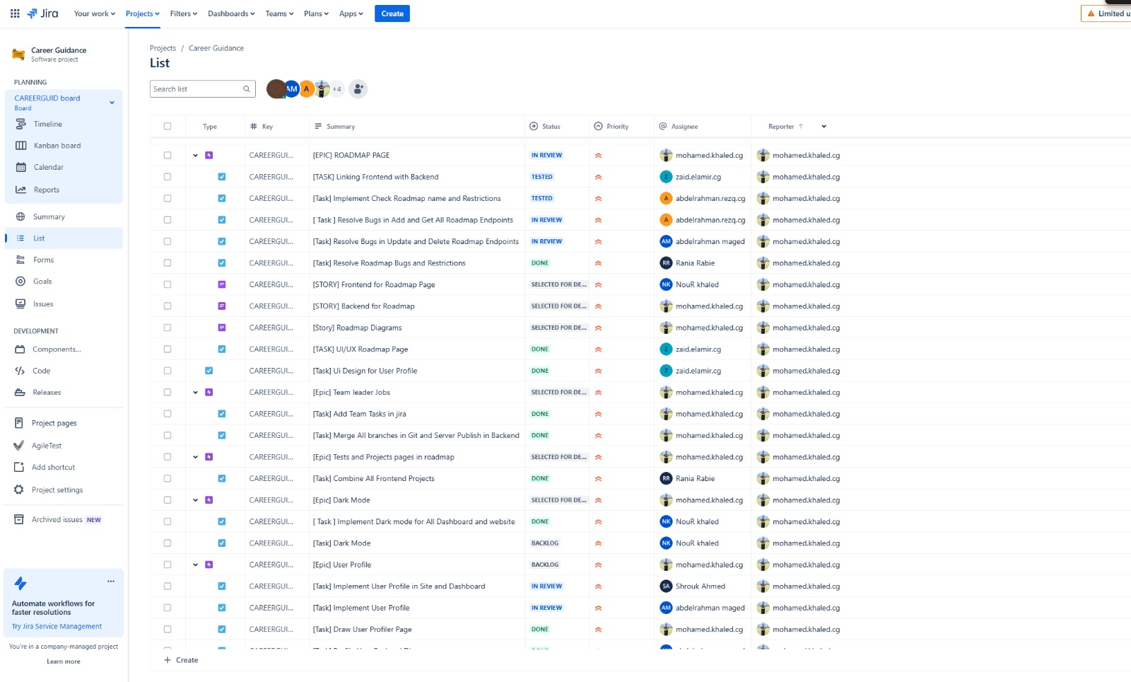
Time Plan

Slide 32

TECHNOLOGIES
UI-UX:
FIGMA
Photoshop
TOOLS :
JIRA
GITHUB
MIRO
Drow.io
LUCIDIA
FRONTEND :
REACT
MUI
REACT FLOW
FIRE-BASE
BACKEND:
.NET
SQL
LINQ
EF Core
Postman
Swagger
31

Slide 33
AGENDA
1
2
3
4
5
Problem Statement
Aims & Objectives
Related Work
Requirements
System Analysis
6
Website
7
Future Work
32

Slide 34

Website
https://devroots-8d8f5.web.app
33

Slide 35
AGENDA
1
2
3
4
5
Problem Statement
Aims & Objectives
Related Work
Requirements
System Analysis
6
Website
7
Future Work
35

Slide 36

Future Work
Job Listings and Company Partnerships
Built-in Interview System (On-site, not external like Google Meet)
Website Performance Optimization and Scalability
AI Integration ) Chatbot for user support)
Paid Courses via Partnerships with Trainers or Companies
36

Slide 37

Any Questions?

Slide 38


Thank You

